Slide 1
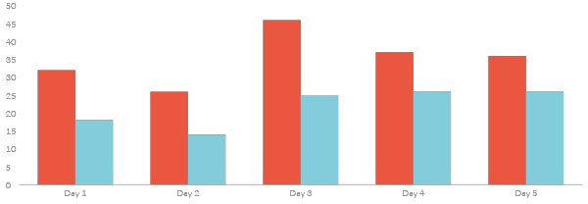
Disability Infographics
Marketing is the study and management of exchange relationships. Marketing is the business process of creating relationships with and satisfying customers.
Awareness
Knowledge
There are people who have a significant number, there are people who have a significant.
There are people who have a significant number, there are people who have a significant.
+500
7,284

Slide 2
Disability Infographics
Marketing is the study and management of exchange relationships. Marketing is the business process of creating relationships with and satisfying customers.
25%
There are people who have a significant number of followers.
Awareness
Knowledge
There are people who have a significant number, there are people who have a significant.
There are people who have a significant number, there are people who have a significant.

Slide 3
Disability Infographics
Marketing is the study and management of exchange relationships. Marketing is the business process of creating relationships with and satisfying customers.
Awareness
Knowledge
There are people who have a significant number, there are people who have a significant.
There are people who have a significant number, there are people who have a significant.

Slide 4
Disability Infographics
Marketing is the study and management of exchange relationships. Marketing is the business process of creating relationships with and satisfying customers.
Your Title
Your Title
1
1
To get your company’s name out there, you need to make sure.
To get your company’s name out there, you need to make sure.
Your Title
Your Title
2
2
To get your company’s name out there, you need to make sure.
To get your company’s name out there, you need to make sure.
Your Title
Your Title
To get your company’s name out there, you need to make sure.
3
3
To get your company’s name out there, you need to make sure.

Slide 5
Disability Infographics
Marketing is the study and management of exchange relationships. Marketing is the business process of creating relationships with and satisfying customers.
There are people who have a significant number.
There are people who have a significant number.
1
2
Awareness
Knowledge
There are people who have a significant number.
There are people who have a significant number.

Slide 6
Disability Infographics
Marketing is the study and management of exchange relationships. Marketing is the business process of creating relationships with and satisfying customers.
Desire
Knowledge
1
To get your company’s name out there, you need to make sure.
3
To get your company’s name out there, you need to make sure.
Awareness
Action
2
To get your company’s name out there, you need to make sure.
4
To get your company’s name out there, you need to make sure.

Slide 7
Disability Infographics
Marketing is the study and management of exchange relationships. Marketing is the business process of creating relationships with and satisfying customers.
c
Awareness
1
There are people who have a significant number, there are people who have a significant.
Knowledge
2
There are people who have a significant number, there are people who have a significant.
Action
3
There are people who have a significant number, there are people who have a significant.

Slide 8
Disability Infographics
Marketing is the study and management of exchange relationships. Marketing is the business process of creating relationships with and satisfying customers.
Awareness
1
There are people who have a significant number, there are people who have a significant.
50%
Knowledge
2
There are people who have a significant number, there are people who have a significant.
35%
75%
Action
3
There are people who have a significant number, there are people who have a significant.

Slide 9
Disability Infographics
Marketing is the study and management of exchange relationships. Marketing is the business process of creating relationships with and satisfying customers.
2017
2018
2019
2020
Desire
Awareness
Knowledge
Action
To get your company’s name out there, you need to make sure.
To get your company’s name out there, you need to make sure.
To get your company’s name out there, you need to make sure.
To get your company’s name out there, you need to make sure.

Slide 10
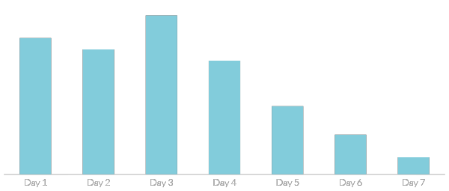
Disability Infographics
Marketing is the study and management of exchange relationships. Marketing is the business process of creating relationships with and satisfying customers.
Awareness
There are people who have a significant number, there are people who have a significant.
To get your company’s name out there.

Slide 11
Disability Infographics
Marketing is the study and management of exchange relationships. Marketing is the business process of creating relationships with and satisfying customers.
2021
Write Something Here
Awareness
Knowledge
To get your company’s name out there.
There are people who have a significant number, there are people who have a significant.c
To get your company’s name out there.

Slide 12
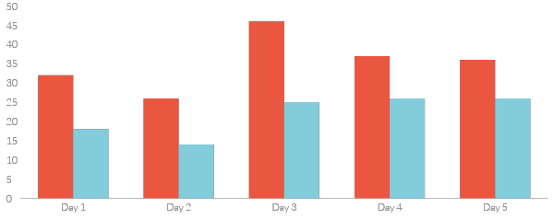
Disability Infographics
Marketing is the study and management of exchange relationships. Marketing is the business process of creating relationships with and satisfying customers.
Awareness
Knowledge
There are people who have a significant number of followers in every business domain on social media.
Your Title
Your Title

Slide 13
Disability Infographics
Marketing is the study and management of exchange relationships. Marketing is the business process of creating relationships with and satisfying customers.
Disability Process
Awareness
Knowledge
There are people who have a significant number.
There are people who have a significant number.
There are people who have a significant number.

Slide 14
Disability Infographics
Marketing is the study and management of exchange relationships. Marketing is the business process of creating relationships with and satisfying customers.
20%
Awareness
There are people who have a significant number, there are people who have a significant.
70%
Knowledge
There are people who have a significant number, there are people who have a significant.

Slide 15
Disability Infographics
Marketing is the study and management of exchange relationships. Marketing is the business process of creating relationships with and satisfying customers.
Awareness
There are people who have a significant number of followers in every business domain on social media.
There are people who have a significant number of followers in every business domain on social media.
There are people who have a significant number of followers in every business domain on social media.
Awareness
To get your company’s name out there.

Slide 16
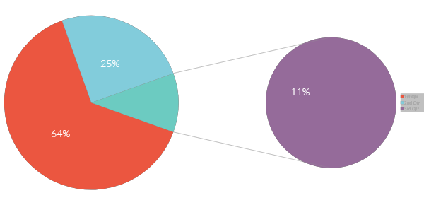
Disability Infographics
Marketing is the study and management of exchange relationships. Marketing is the business process of creating relationships with and satisfying customers.
A
There are people who have a significant number.
B
There are people who have a significant number.
C
There are people who have a significant number.
60%, Write Your Title Here
30%, Write Your Title Here
10%, Write Your Title Here

Slide 17
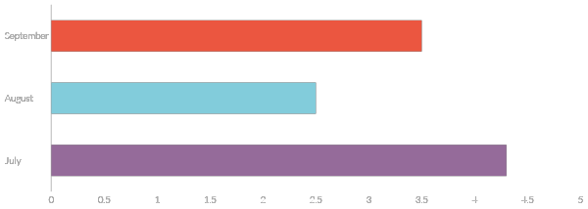
Disability Infographics
Marketing is the study and management of exchange relationships. Marketing is the business process of creating relationships with and satisfying customers.
Disability Process
To get your company’s name out there, you need to make sure that’s why we provide point.
To get your company’s name.
To get your company’s name.
To get your company’s name.

Slide 18


Disability Infographics
Marketing is the study and management of exchange relationships. Marketing is the business process of creating relationships with and satisfying customers.
60%
25%
Awareness
Knowledge
There are people who have a significant number of followers in every business domain on social media.
There are people who have a significant number of followers in every business domain on social media.
To get your company’s name.
To get your company’s name.

Slide 19
Disability Infographics
Marketing is the study and management of exchange relationships. Marketing is the business process of creating relationships with and satisfying customers.
Awareness
01
That’s why we provide point and click solutions that let you choose.
Desire
02
That’s why we provide point and click solutions that let you choose.
Knowledge
03
That’s why we provide point and click solutions that let you choose.
To get your company’s name.
To get your company’s name.
To get your company’s name.

Slide 20
Disability Infographics
Marketing is the study and management of exchange relationships. Marketing is the business process of creating relationships with and satisfying customers.
225
340
500
Awareness
Desire
Knowledge
There are people who have a significant number of followers in every business domain on social media.
There are people who have a significant number of followers in every business domain on social media.
There are people who have a significant number of followers in every business domain on social media.

